Slide 1
Loader

Slide 2
Loader
A loader is a system program that performs the loading function.
Many loaders also support relocation and linking.
Some systems have a linker to perform the linking operations and a separate loader to handle relocation and loading.

Slide 3
Functions of loader
Loading and Allocation – brings the object program into memory for execution.
Relocation – modifies the object program so that it can be loaded at an address different from the location originally specified.
Linking – combines two or more separate object programs and supplies the information needed to allow references between them.

Slide 4
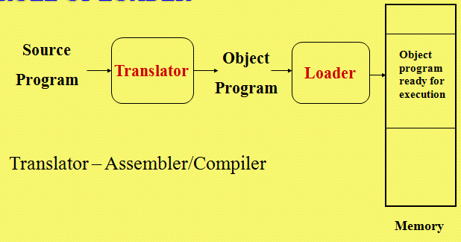
Role of loader

Slide 5
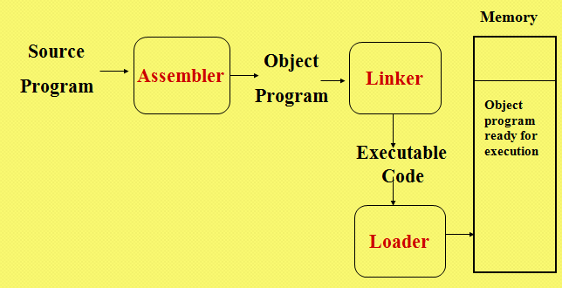
Role of loader and linker

Slide 6
Types of loader
Compile and Go loader
Absolute loader
Relocating loader
Direct-Linking loader

Slide 7
Assemble and go loader
Characteristic
the object code is stored in memory after assembly
single JUMP instruction
Advantage
simple, developing environment
Disadvantage
whenever the assembly program is to be executed, it has to be assembled again
A portion of the memory is wasted as the core occupied by assembler is unavailable to the object program

Slide 8
Absolute loader
Operation is very simple
The object code is loaded to specified locations in the memory
At the end the loader jumps to the specified address to begin execution of the loaded program
Advantages
Make more core available to the user since assembler is not in memory at load time
Simple to implement
Disadvantages
the need for programmer to specify the actual address
difficult to do subroutine linkage
Loader doesn’t perform functions like linking and program relocation

Slide 9
Design of Absolute loader
For a simple absolute loader, all functions are accomplished in a single pass as follows:
1) The Header record of object programs is checked to verify that the correct program has been presented for loading.
2) As each Text record is read, the object code it contains is moved to the indicated address in memory.
3) When the End record is encountered, the loader jumps to the specified address to begin execution of the loaded program.

Slide 10
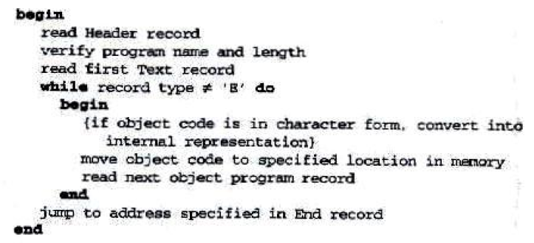
Algorithm for an Absolute loader

Slide 11
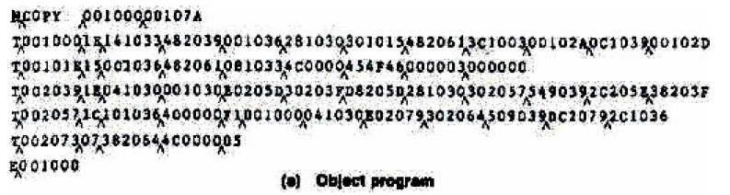

Slide 12
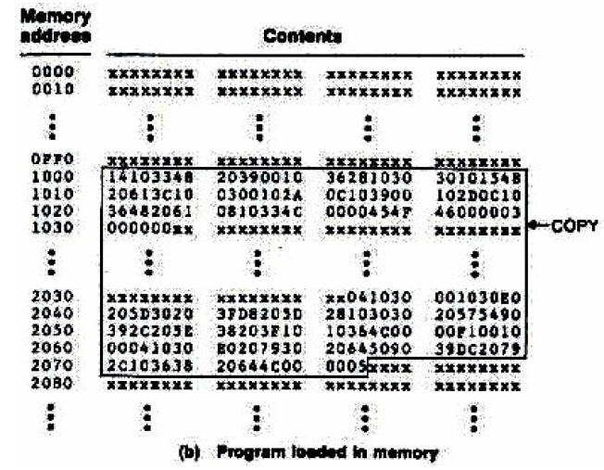

Slide 13
Bootstrap Loader
When a computer is first turned on or restarted, a special type of absolute loader, called a bootstrap loader, is executed.
This bootstrap loads the first program to be run by the computer – usually an operating system
Example (SIC bootstrap loader)
The bootstrap itself begins at address 0
It loads the OS starting address 0x80
No header record or control information, the object code is consecutive bytes of memory
It is in ROM

Slide 14
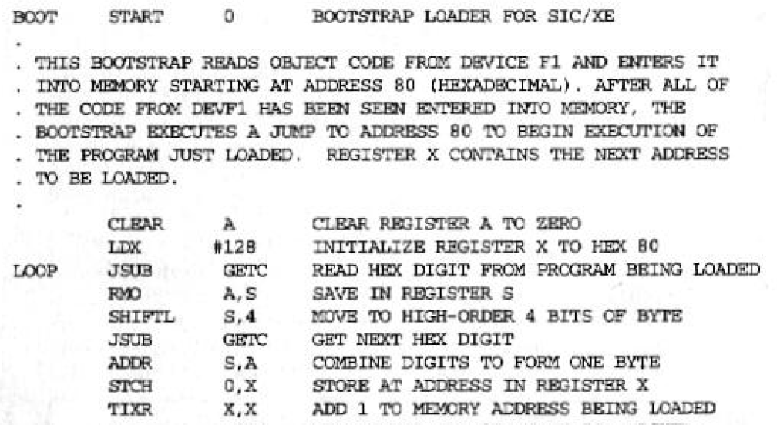

Slide 15
1) The object code from device F1 is always loaded into consecutive bytes of memory, starting at address 80. The main loop of the bootstrap keeps the address of the next memory location to be loaded in register X.
2) After all of the object code from device F1 has been loaded, the bootstrap jumps to address 80, which begins the execution of the program that was loaded.
Much of the work of the bootstrap loader is performed by the subroutine GETC.
GETC is used to read and convert a pair of characters from device F1 representing 1 byte of object code to be loaded.

Slide 16
Relocating loader
Loaders that allow program relocation
Motivation
efficient sharing of the machine with larger memory and when several independent programs are to be run together
support the use of subroutine libraries efficiently
Two methods for specifying relocation
modification record
relocation bit
each instruction is associated with one relocation bit
these relocation bits in a Text record is gathered into bit masks

Slide 17
Modification Record
Modification record
col 1: M
col 2-7:Starting location of the address field to be modified
col 8-9: length (halfbyte)
col 10: flag (+/-)
col 11-17: segment name

Slide 18
Most of the instructions in this program use relative or immediate addressing.
The only portions of the assembled program that contain actual addresses are the extended format instructions on lines 15, 35, and 65. Thus these are the only items whose values are affected by relocation.

Slide 19
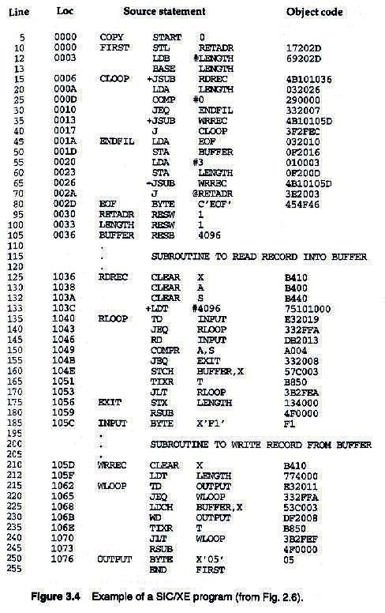

Slide 20
Example
4 B
1 0
1 0
3 6
0006
0007
Red digit indicate 5 half byte is to be modified
0008
0009
Modification record of JSUBM(Line 15): M^000007^05

Slide 21
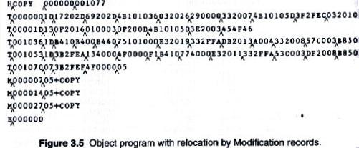

Slide 22
Each Modification record specifies the starting address and length of the field whose value is to be altered.
It then describes the modification to be performed.
In this example, all modifications add the value of the symbol COPY, which represents the starting address of the program.
An object program that contains the information necessary (modification record) to perform this kind of modification is called a relocatable program

Slide 23
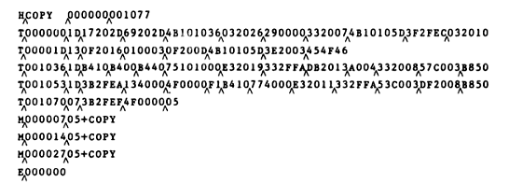

Slide 24
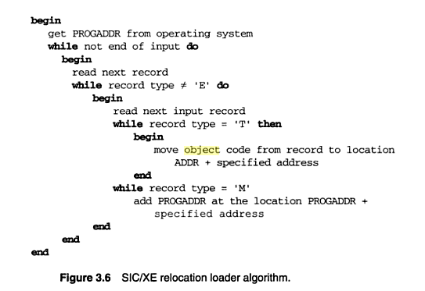

Slide 25
Relocation bit
The modification record scheme is not well suited for use with all machine architecture
On machine that uses direct addressing and has fixed instruction format it is efficient to do relocation using relocation bit
There are no Modification records.
The Text records are the same as before except that there is a relocation bit associated with each word of object code.
Since all SIC instructions occupy one word, this means that there is one relocation bit for each possible instruction.

Slide 26
The relocation bits are gathered together into a bit mask following the length indicator in each Text record.
This mask is represented (in character form) as three hexadecimal digits
If the relocation bit corresponding to a word of object code is set to 1, the program’s starting address is to be added to this word when the program is relocated.
A bit value of 0 indicates that no modification is necessary.
If a Text record contains fewer than 12 words of object code, the bits corresponding to unused words are set to 0.

Slide 27
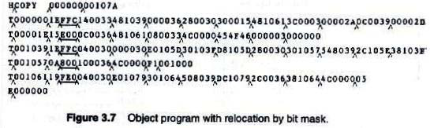
Example
For example, the bit mask FFC (representing the bit string 111111111100) in the first Text record specifies that all 10 words of object code are to be modified during relocation.

Slide 28
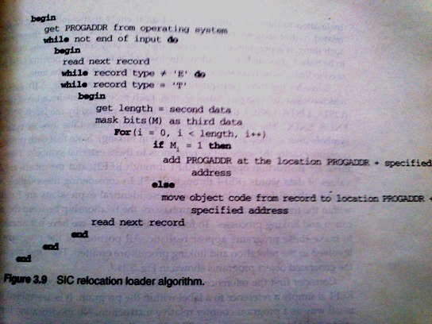
Relocation Loader Algorithm

Slide 29
Linking Loader
It perform three function:
Relocation
Linking
Loading
The input to such a loader consist of a set of object program(i.e. control sections) that are to be linked together
The linking loader make two passes over its input to resolve external references between control section
Pass 1 assign address to all external symbols
Pass 2 perform the actual loading, relocation and linking

Slide 30
The main data structure needed for linking loader is an external symbol table ESTAB ( analogous to SYMTAB)
ESTAB store name and address of each external symbol in the set of control section being loaded.
The table also indicate in which control section the symbol is defined.
A hashed organization is typically used for this table.

Slide 31
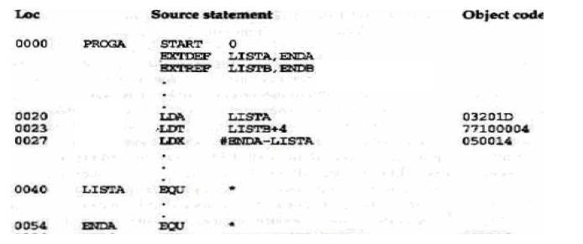
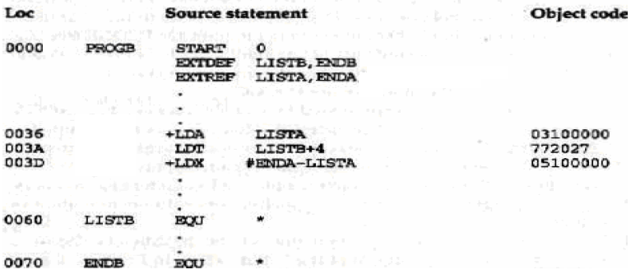

Slide 32
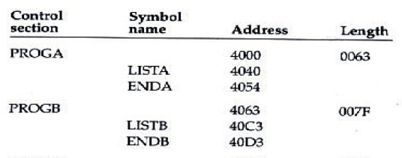

Slide 33
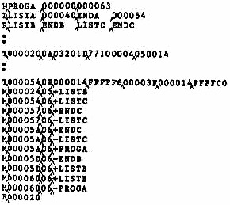

Slide 34
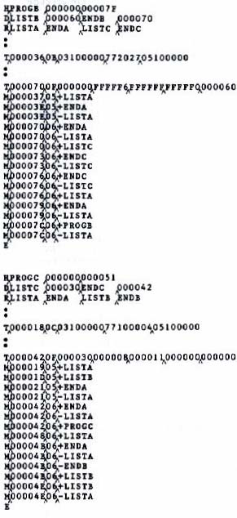

Slide 35
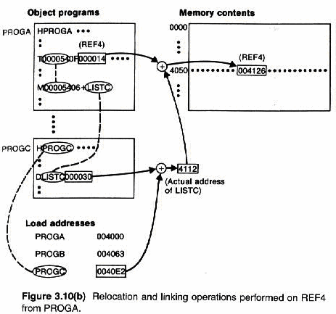

Slide 36
Pass 1 Program Logic
Pass 1:
assign addresses to all external symbols
Variables & Data structures
PROGADDR (program load address) from OS
CSADDR (control section address)
CSLTH (control section length)
ESTAB
During Pass 1 , the loader is concerned only with Header and Define record types in the control sections.

Slide 37
STEPS in PASS 1
1) The beginning load address for the linked program (PROGADDR) is obtained from the OS. This becomes the starting address (CSADDR) for the first control section in the input sequence.
2) The control section name from Header record is entered into ESTAB, with value given by CSADDR. All external symbols appearing in the Define record for the control section are also entered into ESTAB. Their addresses are obtained by adding the value specified in the Define record to CSADDR.
3) When the End record is read, the control section length is added to CSADDR. This calculation gives the starting address for the next control section in sequence.
4) At the end of Pass 1, ESTAB contains all external symbols defined in the set of control sections together with the address assigned to each.

Slide 38
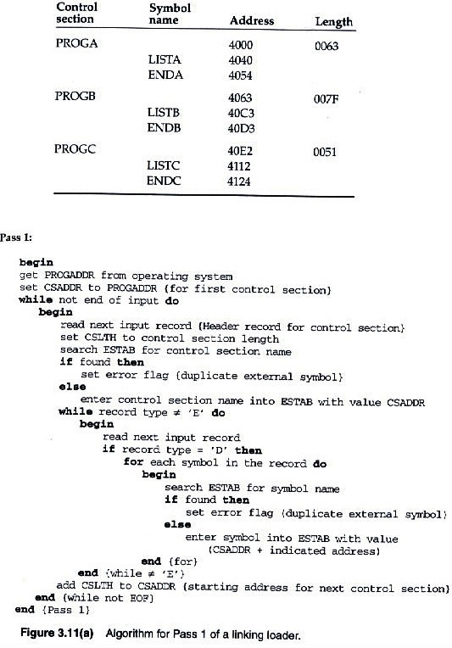

Slide 39
Pass 2 Program Logic
Pass 2:
perform the actual loading, relocation, and linking
Modification record
lookup the symbol in ESTAB
End record for a main program
transfer address
Process Text record and Modification record

Slide 40
Steps in pass 2
1) As each Text record is read, the object code is moved to the specified address (plus the current value of CSADDR).
2) When a Modification record is encountered, the symbol whose value is to be used for modification is looked up in ESTAB.
3) This value is then added to or subtracted from the indicated location in memory.
4) The last step performed by the loader is usually the transferring of control to the loaded program to begin execution.

Slide 41
The End record for each control section may contain the address of the first instruction in that control section to be executed.
Our loader takes this as the transfer point to begin execution
If more than one control section specifies a transfer address, the loader arbitrarily uses the last one encountered.
If no control section contains a transfer address, the loader uses the beginning of the linked program (i.e., PROGADDR) as the transfer point.
Normally, a transfer address would be placed in the End record for a main program

Slide 42
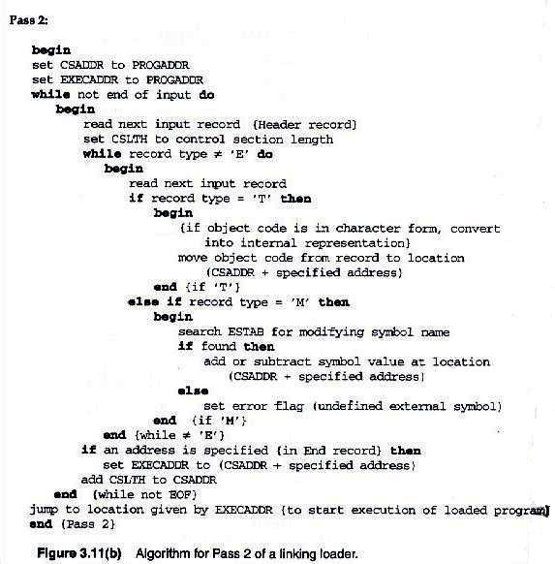

Slide 43
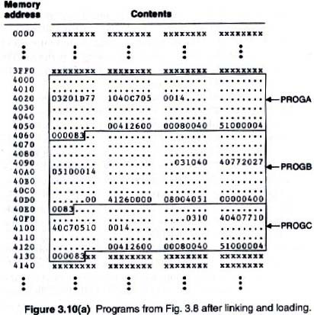

Slide 44
Improve Efficiency
Use local searching instead of multiple searches of ESTAB for the same symbol
assign a reference number to each external symbol
the reference number is used in Modification records
Implementation
01: control section name
other: external reference symbols

Slide 45
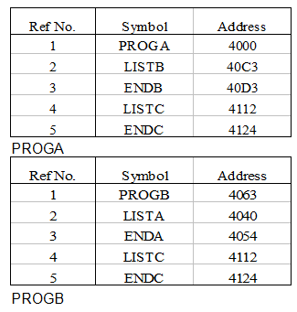

Slide 46
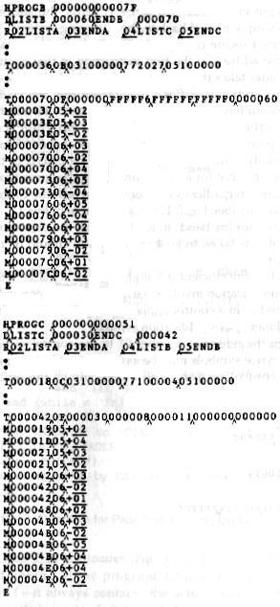

Slide 47
Variants of basic model
Automatic library search
Linkage Editor
Dynamic Linking

Slide 48
Automatic Library Search
It is a feature which many linking loaders have which help them to incorporate routines from a subprogram library into program being loaded
The subroutine called by the program are automatically fetched from library ,linked with the main program and loaded
On some system this feature is referred to as automatic library call

Slide 49
How it is done?
Linking loader use symbol table ESTAB to keep track of external symbol that are referred to but not defined in the primary input to linking loader
At the end of Pass 1, the symbols in ESTAB that remain undefined represent unresolved external references.
The loader searches the library (by scanning define record of all object program on library) or libraries specified for routines that contain the definitions of these symbols
Processes the subroutines found by this search exactly as if they had been part of the primary input stream.

Slide 50
Note: that the subroutines fetched from a library in this way may themselves contain external references. It is therefore necessary to repeat the library search process until all references are resolved.
If unresolved external references remain after the library search is completed, these must be treated as errors.

Slide 51
Scanning the define record of all object program on the library is an inefficient method.
An efficient method to search routine in library is to use a special file structure
This structure contains directory that gives the name of each routine and a pointer to its address within the file.
If a subroutine is called by more than one name that name are entered into the directory(using different entry point). Both entry point to the same location
Thus library search involves a search of the directory followed by reading the object program indicated by this search

Slide 52
Linkage Editor
Linkage editors, which perform linking prior to load time
A linkage editor produces a linked version of the program (load module or executable image), which is written to a file or library for later execution.

Slide 53
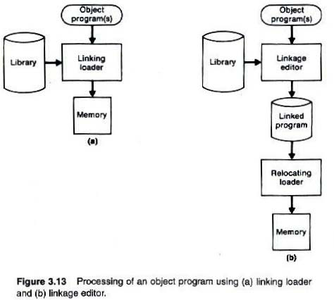
Difference between linkage editor and linking loader

Slide 54
The linkage editor performs relocation of all control sections relative to the start of the linked program.
Thus, all items that need to be modified at load time have values that are relative to the start of the linked program.
This means that the loading can be accomplished in one pass with no external symbol table required.
If a program is to be executed many times without being reassembled, the use of a linkage editor substantially reduces the overhead required.

Slide 55
Linkage editors can perform many useful functions besides simply preparing an object program for execution. Ex., a typical sequence of linkage editor commands to replace subroutine in the linked version is as follows:
INCLUDE PLANNER (PROGLIB)
DELETE PROJECT {delete from existing PLANNER}
INCLUDE PROJECT (NEWLIB) {include new version}
REPLACE PLANNER (PROGLIB)
Linkage editors can also be used to build packages of subroutines or other control sections that are generally used together. This can be useful when dealing with subroutine libraries that support high-level programming languages.
INCLUDE READR(FTNLIB)
INCLUDE WRITER(FTNLIB)
SAVE FTNIO(SUBLIB)

Slide 56
Compared to linking loaders, linkage editors in general tend to offer more flexibility and control.
In linkage editor, resolution of external references and library searching is only performed once ( when program is link edited). In contrast a linking loader search libraries and resolve references every time program is executed.
linking loader outperform Linkage editor in the following cases:
When program is reassembled for nearly every execution(e.g student programs)
When a program is used infrequently then storing the assembled version of program is wastage

Slide 57
Dynamic Linking
Linkage editors perform linking operations before the program is loaded for execution. Linking loaders perform these same operations at load time
Dynamic linking, dynamic loading, or load on call postpones the linking function until execution time: a subroutine is loaded and linked to the rest of the program when it is first called.
Dynamic linking is often used to allow several executing programs to share one copy of a subroutine or library, ex. run-time support routines for a high-level language like C.

Slide 58
Dynamic linking can avoid the necessity of loading the entire library for each execution except those necessary subroutines.
Fig 3.14 illustrates a method in which routines that are to be dynamically loaded must be called via an OS service request.

Slide 59
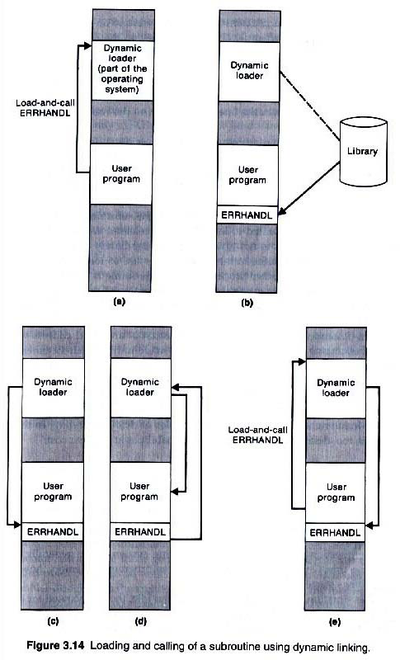

Slide 60
Fig 3.14(a): Instead of executing a JSUB instruction referring to an external symbol, the program makes a load-and-call service request to OS. The parameter of this request is the symbolic name of the routine to be called.
Fig 3.14(b): OS examines its internal tables to determine whether or not the routine is already loaded. If necessary, the routine is loaded from the specified user or system libraries.
Fig 3.14(c): Control is then passed from OS to the routine being called
Fig 3.14(d): When the called subroutine completes it processing, it returns to its caller (i.e., OS). OS then returns control to the program that issued the request.
Fig 3.14(e): If a subroutine is still in memory, a second call to it may not require another load operation. Control may simply be passed from the dynamic loader to the called routine.

Slide 61
Advantages
Dynamic loading provides the ability to load the routine only when ( and if) they are needed.
It avoid the necessity of loading the entire library for each execution.
It make it unnecessary for the program to know the possible set of subroutines that might be used(e.g. the program that allow interactive call)
Delayed binding of subroutine results in greater flexibilty.

Slide 62
Thank you!!!

